Slide 1
Progress Report

Slide 2
Current Situation
Made a simple prototype in Python. Can do quantified signal support recovery via multicoset sampling.
Had various result using two different ways to generate training/test data.

Slide 3
Workflow--My implementation
Generate support as a binary vector.
Generate frequency domain signal by convoluting the support with a square wave.
Do inversed fourier transform, get the time domain expression.
Do multicoset sampling.
Quantify the sampled signal
Put the [quantified signal, support] pair into the learning machine.

Slide 4
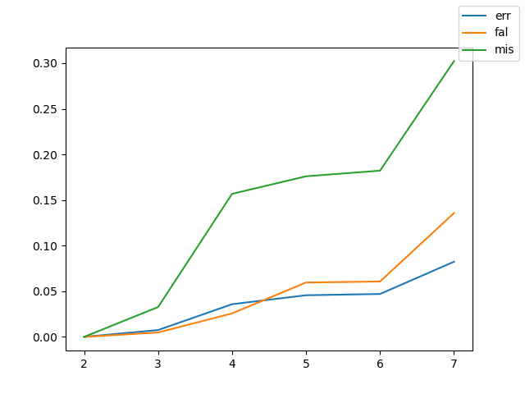
Result-My implementation
ratio of occupied bands:total bands:cosets to 1:5:2
perfect score at 10 subbands.
The result slowly deteriorates as we kept the NN at the same size, and the problem becoming increasingly hard.

Slide 5
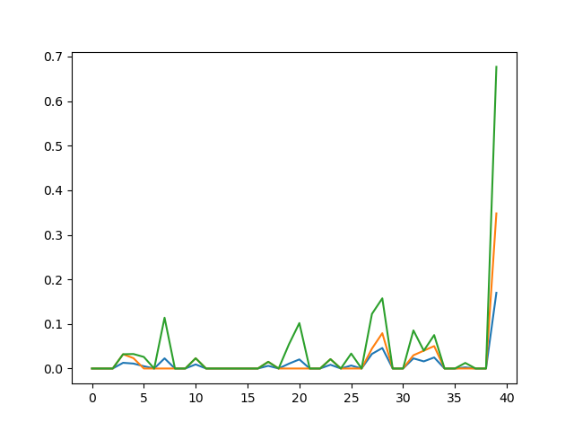
the effect of width
Changing the width of the subbands should not have too much impact.
No clear pattern shown when width varies from 3 to 81

Slide 6
Yang's implementation
Generate time domain signal directly.
The signal being complex, instead of real.
Accidently inputed unsampled data into the learning machine
Horrible result with more informative input.
NN too simple for a complex input?

Slide 7
Yang's implementation, sampled
occupied bands:total bands:cosets
4:40:8
1000 training epochs with 1000 samples
error Rate: 0.03265
False Alarm: 0.08425
Mis Detection: 0.25825

Slide 8
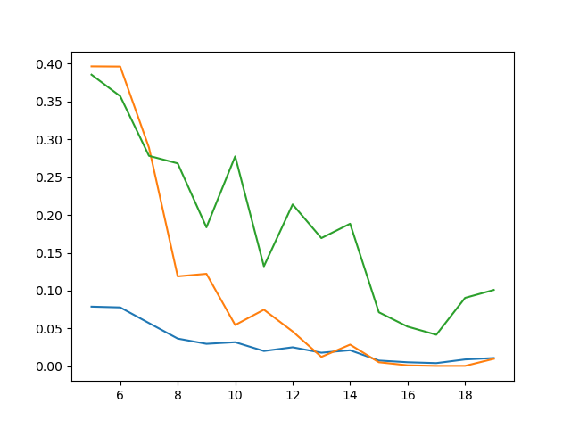
Yang's implementation, sampled2
Changing coset number from 5 to 20
Error drops
Could see the randomness of NN

Slide 9
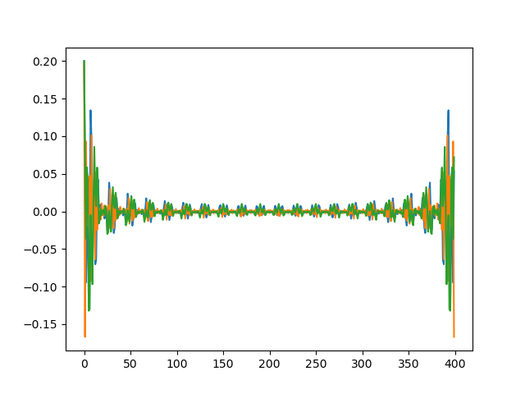
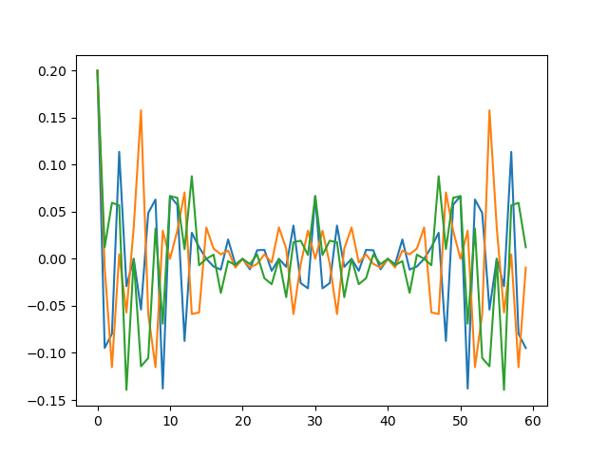
Problems--signal generate
Time domain signal's peak vs average become worse when width grows in my implementation
Probably not practical

Slide 10
Problems--Other
Quantification method
a quantifier with cutoff, based on the average energy of the signal
NN structure
IQ signal + CNN?
LSTM?

